Slide 1
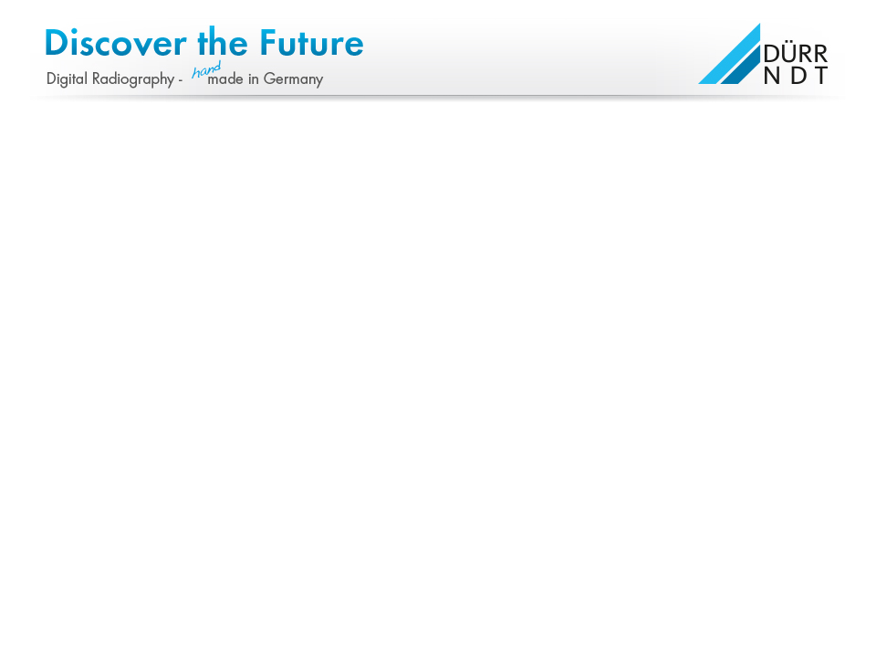


Slide 2
Digital vs. analog

Slide 3
Limiting factors in NDT
We asked customers, about the reason not having invested into digital yet.
Personnel
Workflow
Cost
Applicability
Image quality
Standards

Slide 4
Limiting factors in NDT
Personnel
Workflow
Cost
Applicability
Image quality
Standards

Slide 5
Limiting factors in NDT
Personnel
Both
ASTM as well as
EN Standards are released.
Workflow
Cost
Applicability
Image quality
Standards

Slide 6
Limiting factors in NDT
Personnel
Image quality is as good as film
(depends on device of course)
Workflow
Cost
Applicability
Image quality

Slide 7
Limiting factors in NDT
Personnel
Imaging Plates are as flexible as film and available in similar formats
No limitations here.
Workflow
Cost
Applicability

Slide 8
Limiting factors in NDT
Personnel
Cost per film/chemistry/
processor cleaning/
archiving is
higher than for digital
Workflow
Cost

Slide 9
Limiting factors in NDT
Personnel
The
current workflow
is indeed
not as easy as
it is with film!
Workflow

Slide 10
Limiting factors in NDT
Personnel
Workflow
The
majority of the personnel is not used to a computer and software!
The
current workflow
is indeed
not as easy as
it is with film!

Slide 11
Developing an idea…
THE REQUIREMENT
Simplify the workflow to be similar to film!
Make the operation as easy as possible - make it fool-proof!
Enable the operator on site (Level I) to easily acquire images, without the need
to operate a PC/Laptop and Software.
The idea for services on site:
Develop an autonomous scanner, which runs without PC/Laptop, but allows to
preview the result and have the Level II/III consequently do the interpretation
back in the office as done today.
The idea for factory use:
Enable the level II/III to load jobs with predefined scan modes according to
individual batch or item numbers onto the scanner. Have the operator just pick
the job related to the object exposed and release it for final interpretation after
pre-view.

Slide 12
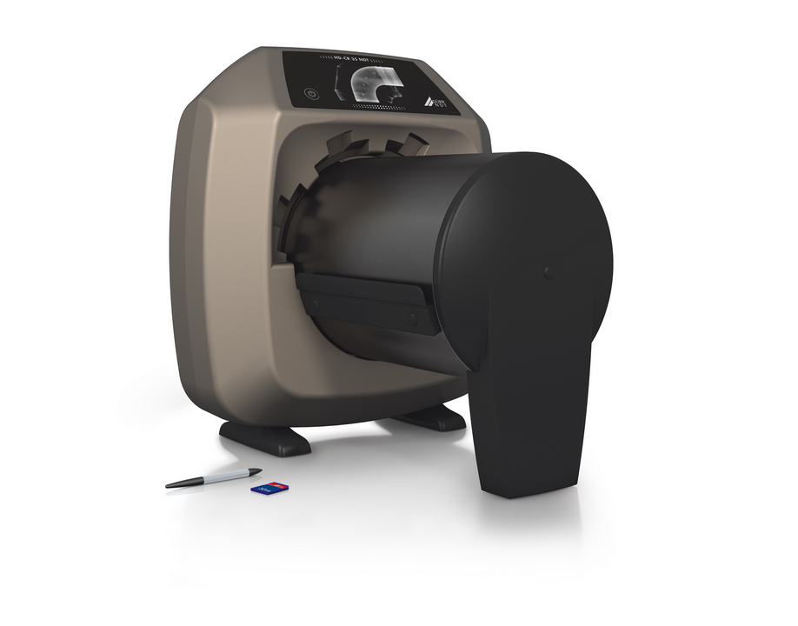
Solution: The new HD-CR 35 NDT
4,3“ full colour touch display
Integrated
Mini-PC
W-Lan on board
Adjustable laser spot size
SD-memory card with up to 32 GB

Slide 13
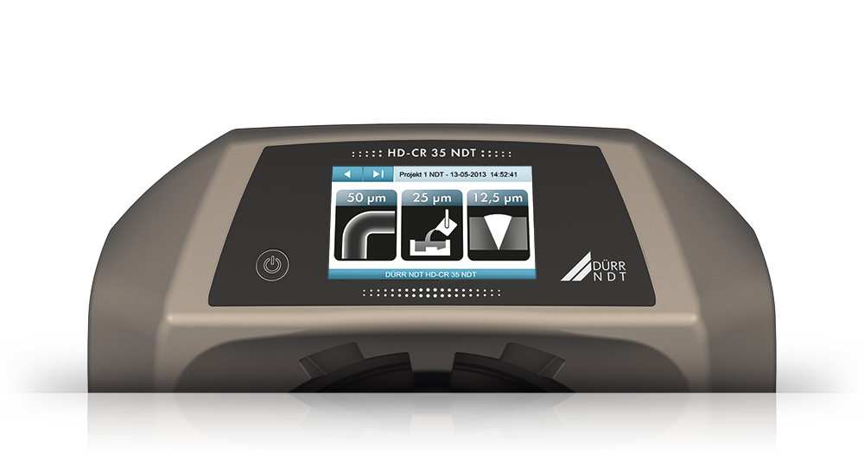
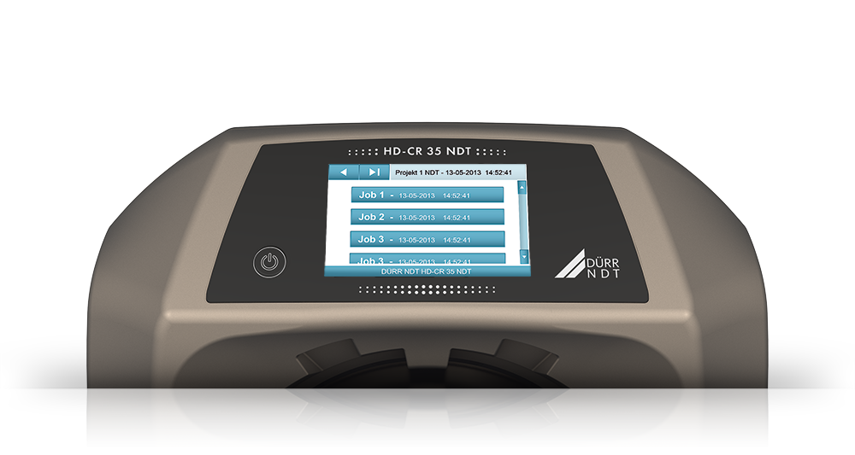
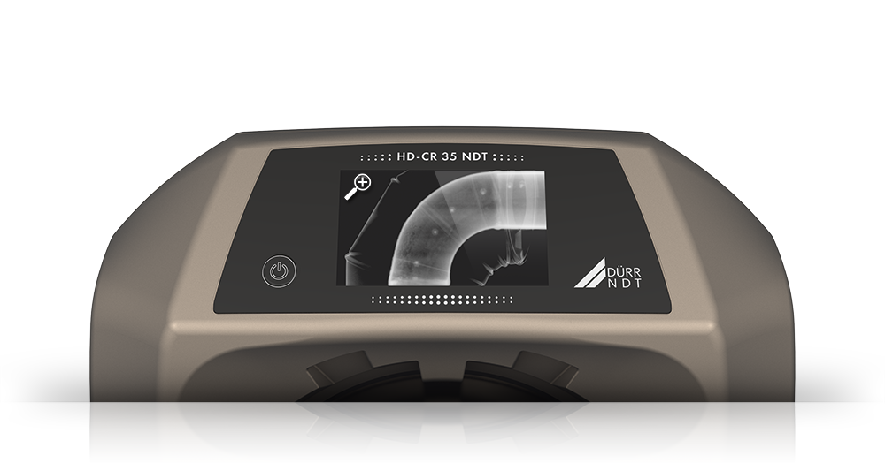
4,3“ HD-Display
Full colour
High res (800 x 480 px)
Touch functionality
Stylus enabled
4,3“ HD-Display

Slide 14
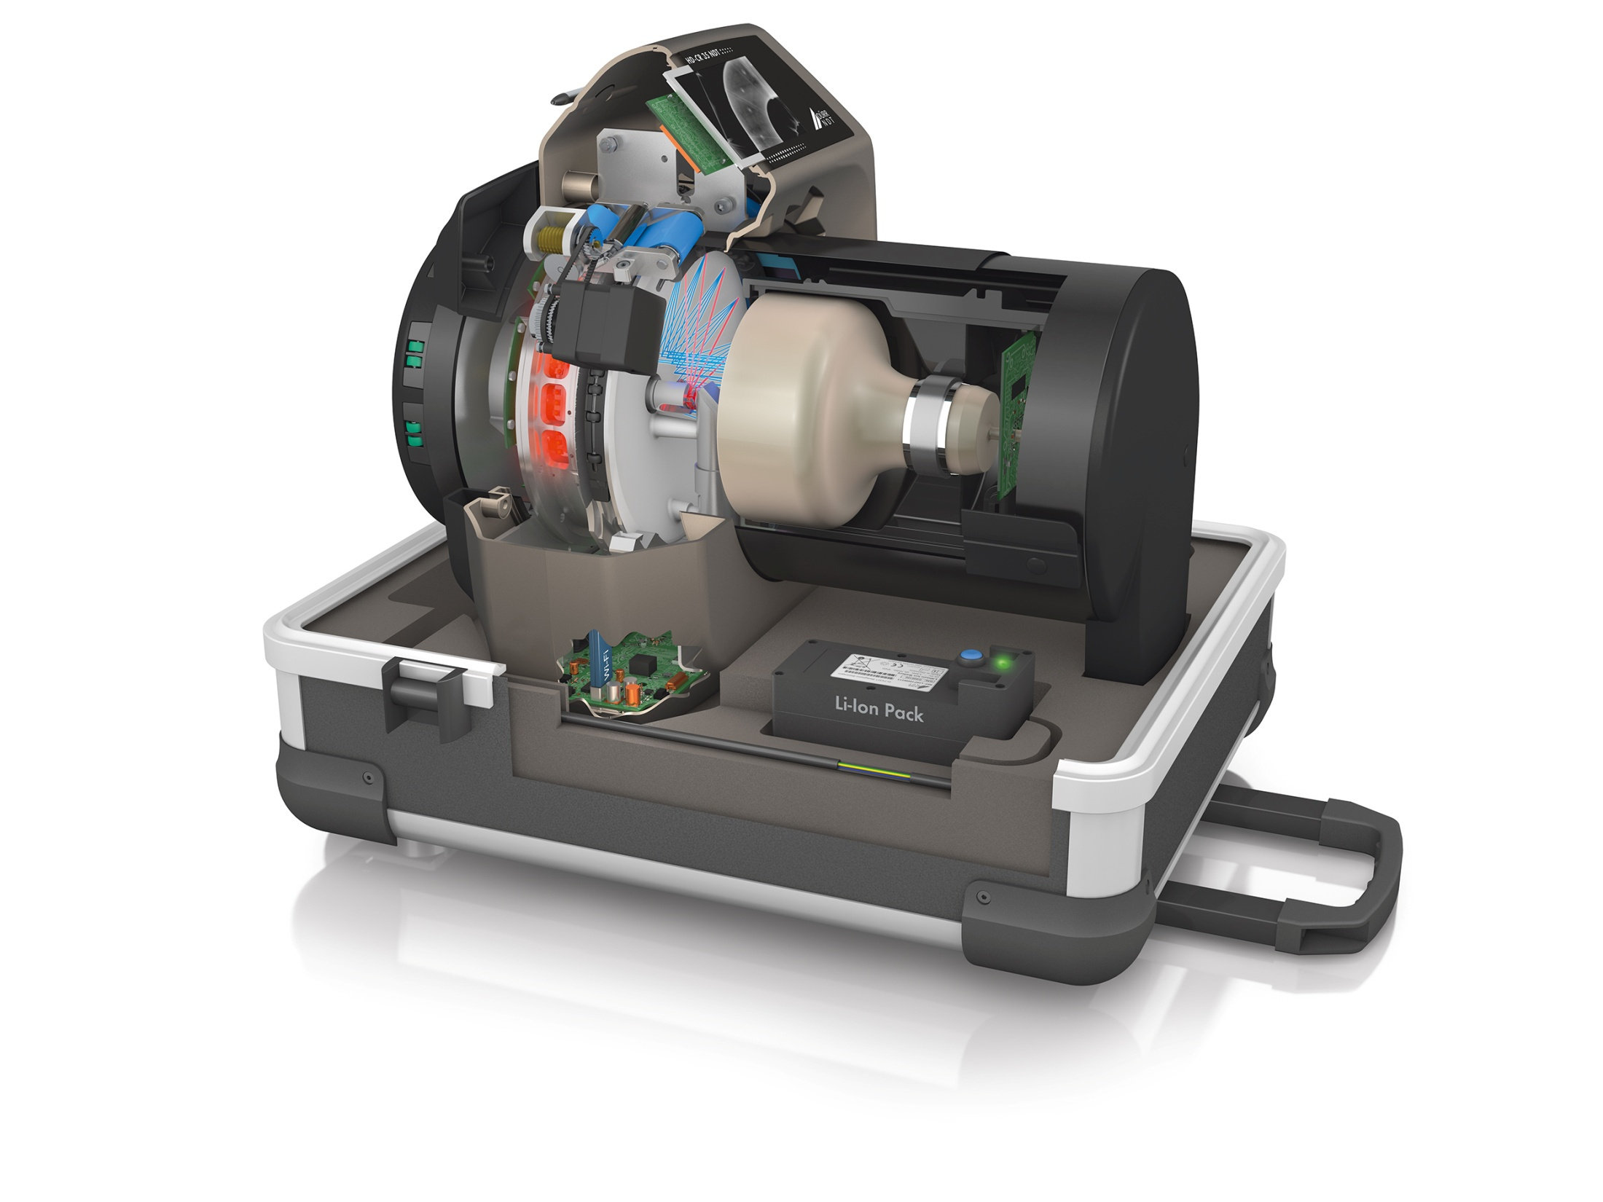
Unique Features
The build in Mini-PC allows
the fully autarcic operation.
The scanner functions
without being connected
to a Laptop or PC
Build in Mini-PC

Slide 15

Unique Features
The on board W-Lan adapter
allows to connect the device with the network in no time.
Connection via Ethernet cable also possible.
W-Lan on board

Slide 16
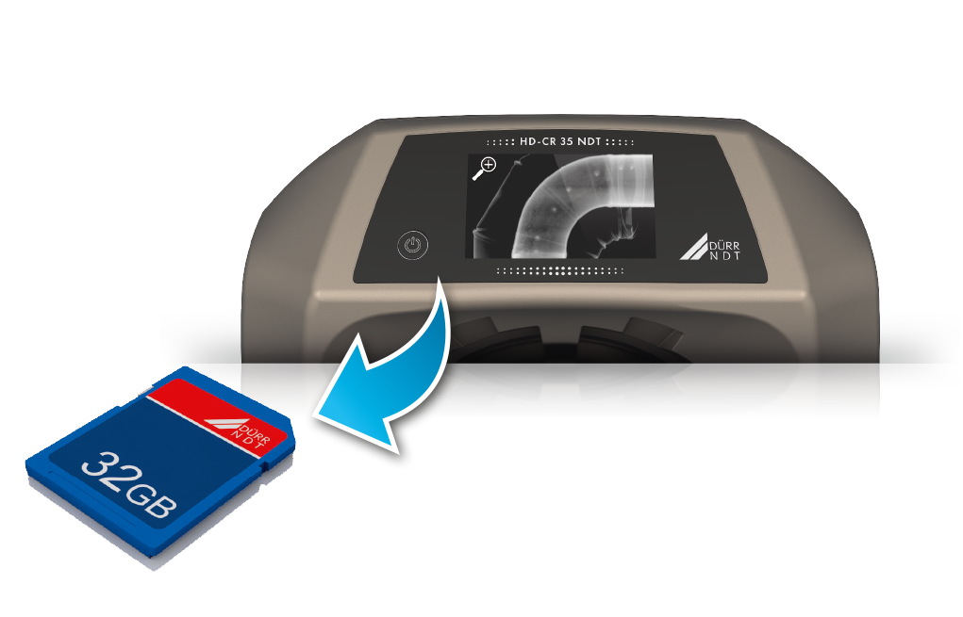
Unique Features
A SDHC memory card with up to 32 GB may be used to save all images taken while offline.
The SDHC memorey card acts as a back-up solution also, in case of network failures.
SDHC memory card

Slide 17
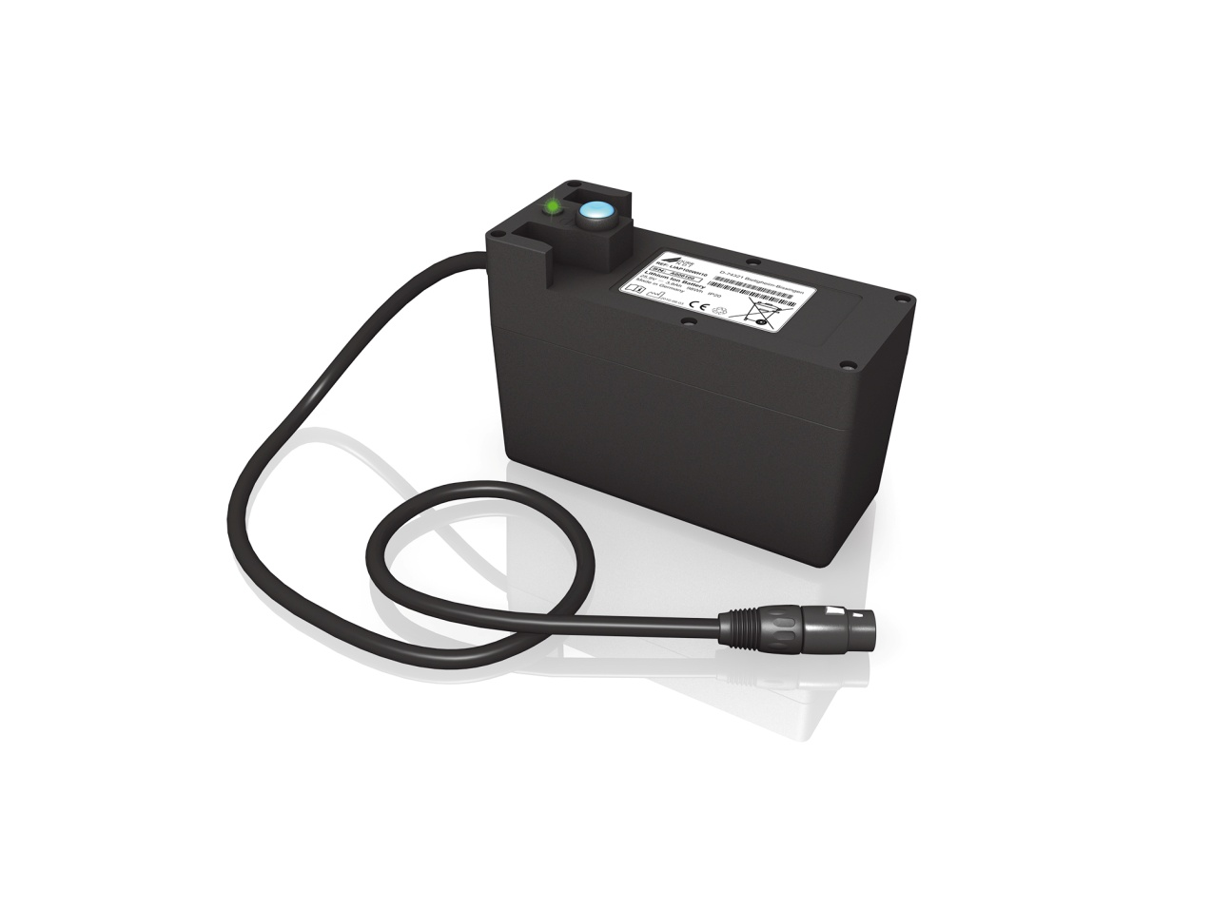
Unique Features
The optional Li-Ion Battery pack powers the unit several hours.
With the battery pack the scanner becomes a fully autarcic system
– ideal for field inspection.
Autonomus funtion

Slide 18
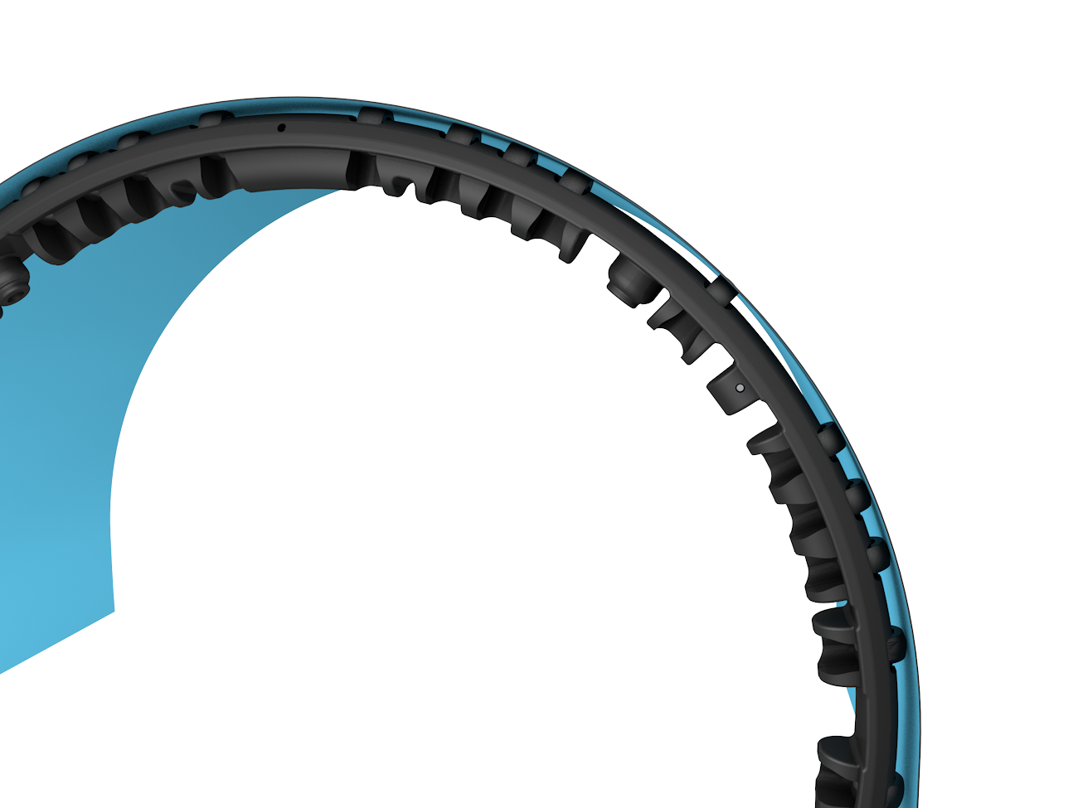
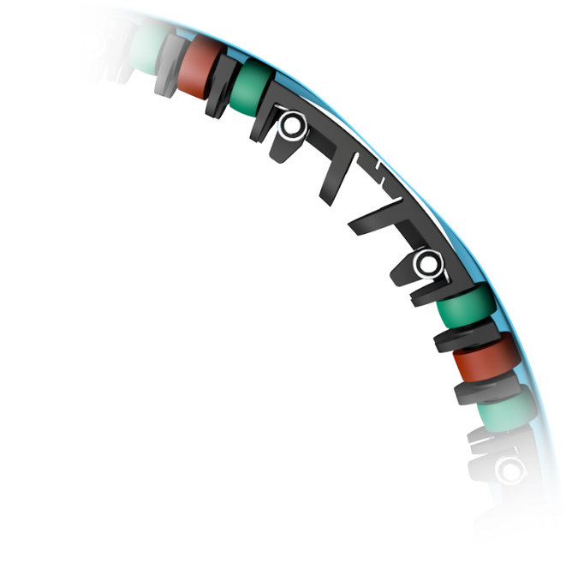
Unique Features
With the pin roller set, the homogenity of the image is outstanding and IPs are conserved.
Plus, any IP size, even individual shapes, may be scanned with no need for a template.
Improved roller set

Slide 19
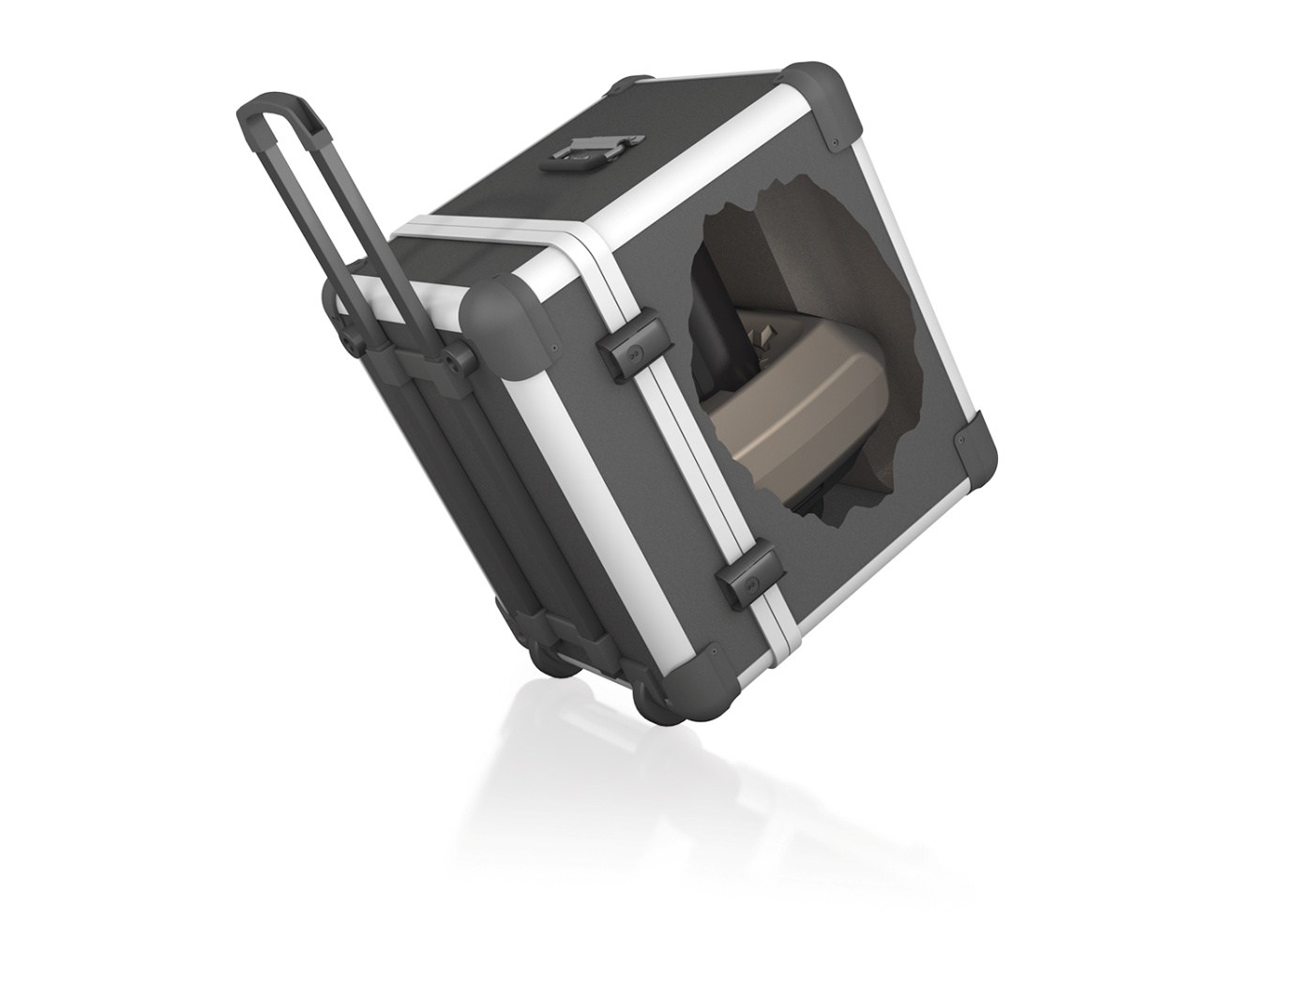
Unique Features
With just 17,5 kg (38,5 lbs) it is the lightest full format scanner worldwide.
Within the flight case the total weight is just below 28 kg, including one battery pack!
Reduced weight

Slide 20
Film vs. Imaging Plate
The workflow is also affected by the differences between film and IP.
Film | Imaging Plate | Imaging Plate SR_{b} limit
C1 no truly equivalent IP - / -
C2 – C3 high resolution blue IP < 40 µm
C4 high resolution white IP 50 – 70 µm
C5 – C6 low resolution, fast white IP > 70 µm
For conventional film, the correct film-class and a minimum/maximum OD are basic
requirements to proceed with the interpretation.
For IP technology, the SNR_{n} plays an important role in terms of image quality.
The desire:
An easy way to achieve a high SNR_{n} without hassles.

Slide 21

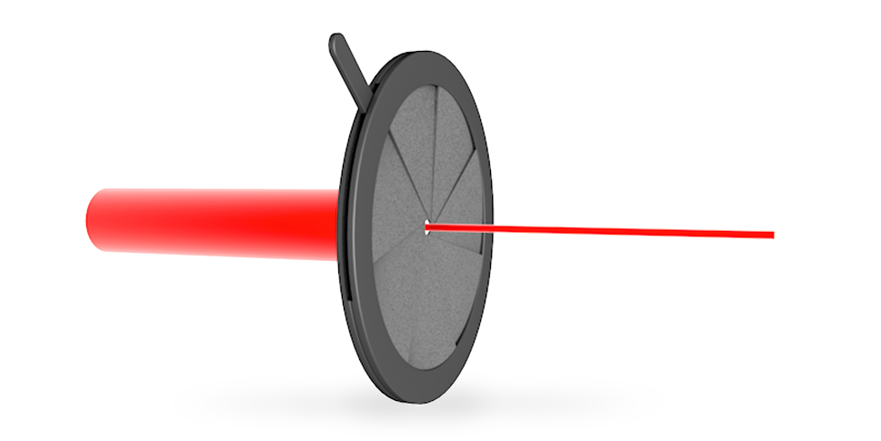
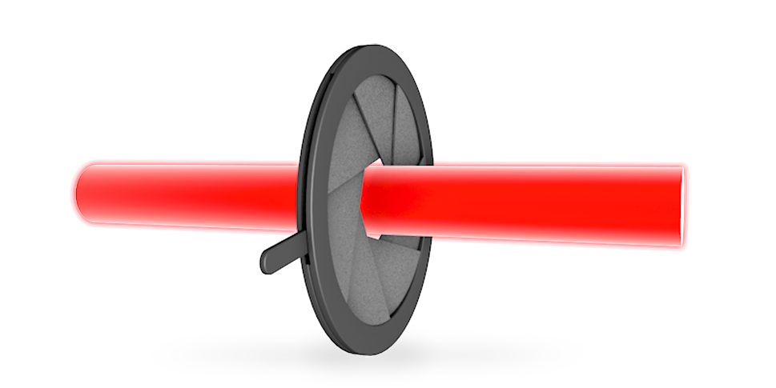
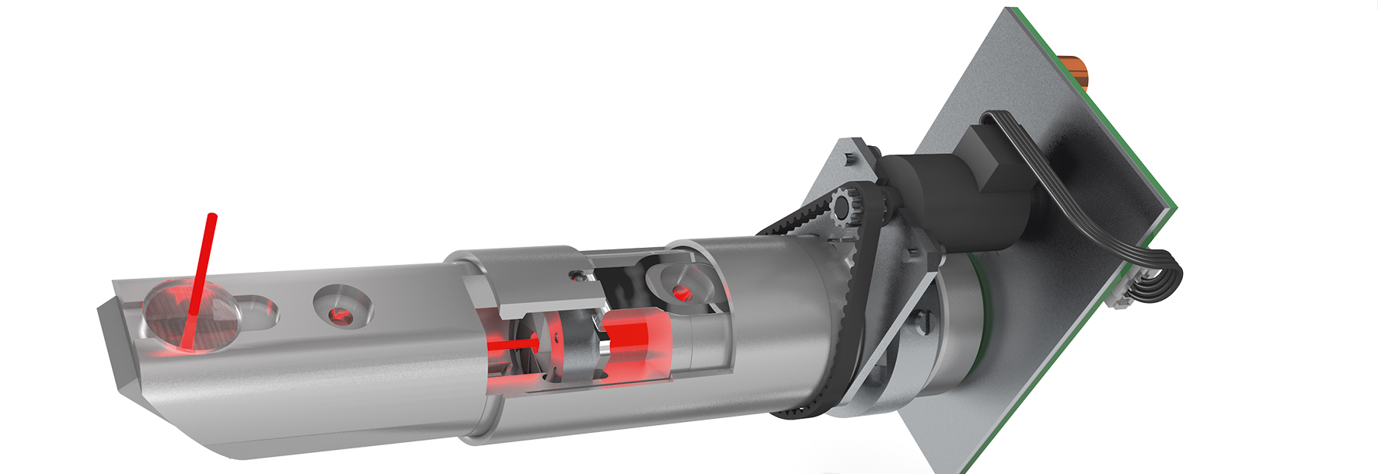
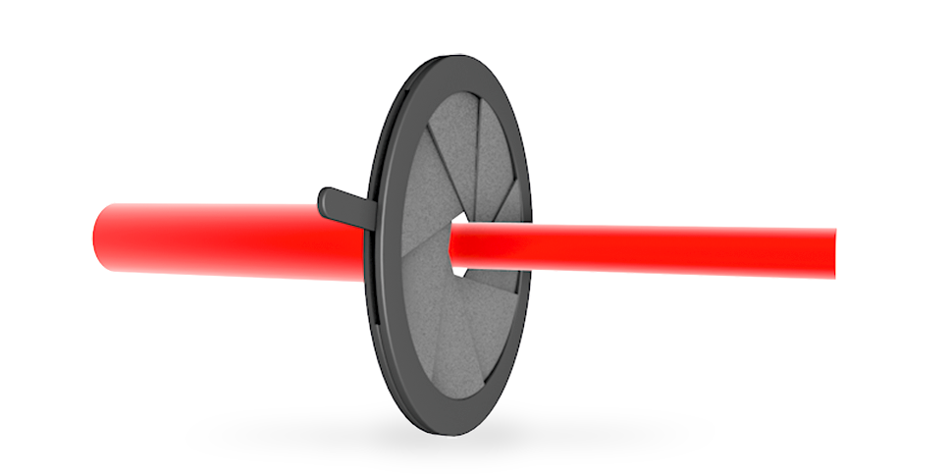
Introducing:
TreFoc is a combination of Trēs (lat. for 3) and Focus
It stands for the capability to utilize the benefit from three different spot sizes in one laser optic.
A scanner with TreFoc Technology combines the benefit from 3 different units.
What is TreFoc Technology?
50 µm
12,5 µm
25 µm

Slide 22

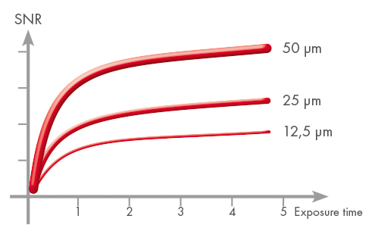
The idea
Findings:
A small spot size provides a high SRb but the SNR is comparatively low.
A bigger laser spot provides a low SRb but the SNR is comparatively high.
Idea:
Provide a technology, which offers the perfect laser spot size for the individual application,IP and source used.
Always perfect SNR values
Spot-Size to SNR relation

Slide 23
Iris set to 12,5µm
12,5 µm
Iris diaphragma almost closed
Best match for high resolution Imaging Plates
Perfectly suited for weld seam inspection
Best choice for aerospace application
Better results than film for thin material
High normalized SNR due to 40 µm BSR
Technique
Benefit of a 12,5 µm focal spot

Slide 24
Iris set to 25µm
25 µm
Iris diaphragma half open
Enhanced SNR
Best match for „high res white“ Imaging Plates
Perfectly suited for cast inspection
Best choice for weld inspection with Isotopes
Relatively small file size
Relatively fast scanning process
Technique
Benefit of a 25 µm focal spot

Slide 25
Iris set to 50µm
50 µm
Iris diaphragma fully open
Ideal SNR for low res. Application
Best match for fast (white) Imaging Plates
Perfectly suited for CUI
Best choice for most Isotope work
Small file size
Fast scanning process
Shorter exposure time
Technique
Benefit of a 50 µm focal spot

Slide 26
Unique Technology
Three different „devices“ in one scanner
High normalized SNR almost guaranteed
No matter what task – always the perfect match
Perfectly matched for different IPs (High Res, General and Basic)
Cristal Clear images for every application
Reduced exposure time for Isotope work
Simplified operation especially for mobile application
Very little operator training needed, no PC/Software knowledge required
Three systems in ONE - Technical advantages

Slide 27

in action

Slide 28
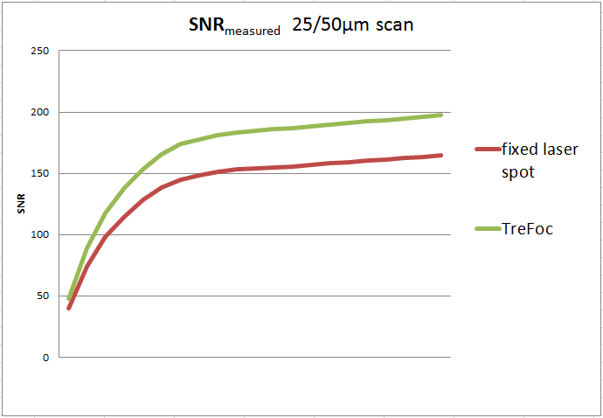
SNR_{measured} comparison
Comparative measurement have shown an improved SNR_{measured} by 20% in
average for TreFoc Technology. This however applies to scans of 25/50µm only.

Slide 29
The next level in CR
How helps to make
the transition to digital easier.

Slide 30

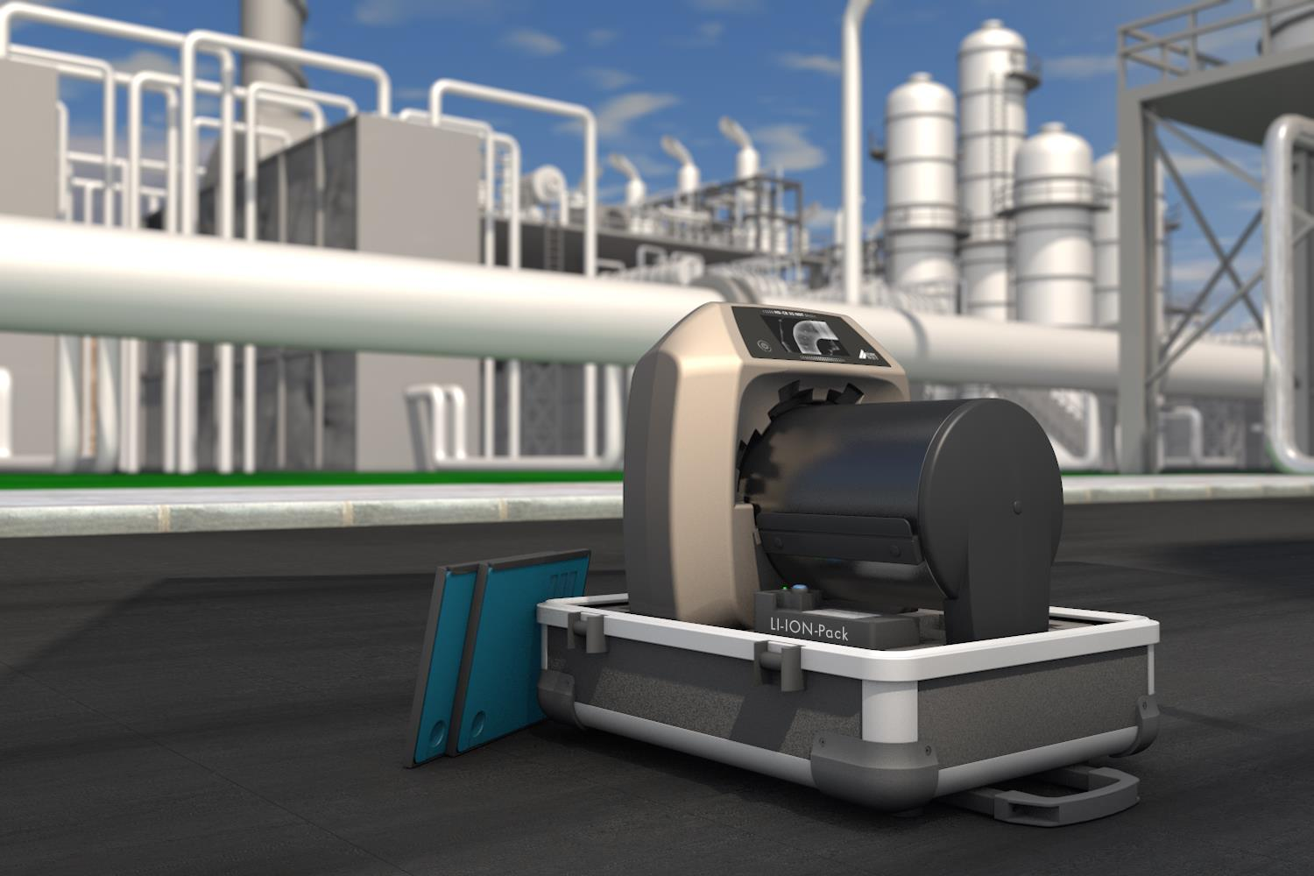
SITUATION:
A crew has prepared for the night shift in
a refinery.
A white (fast response) Imaging Plate
has been exposed.

Slide 31
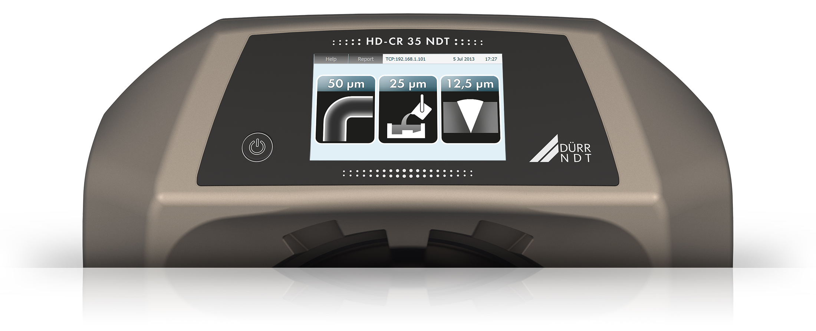

First screen

Slide 32
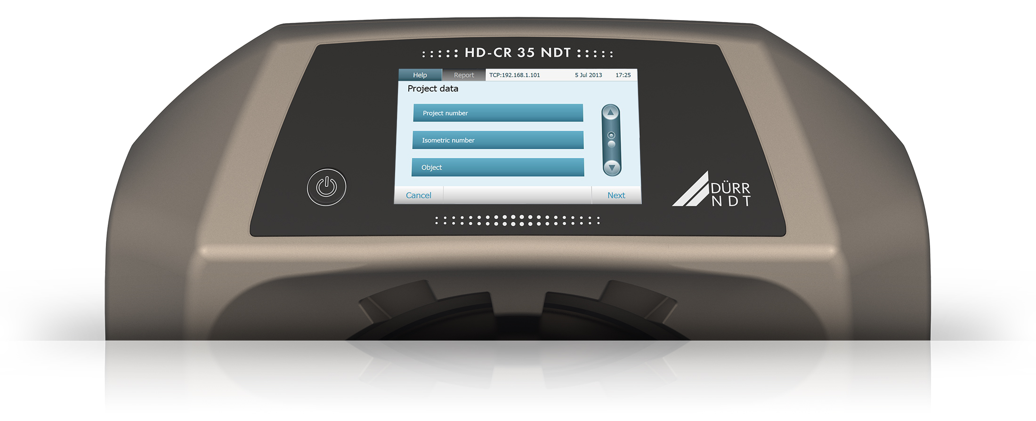
Optional screen

Slide 33
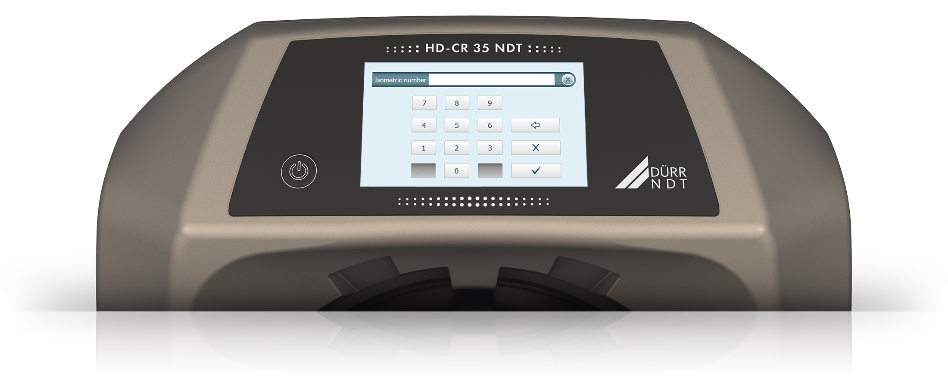
Optional screen
2-752-13

Slide 34
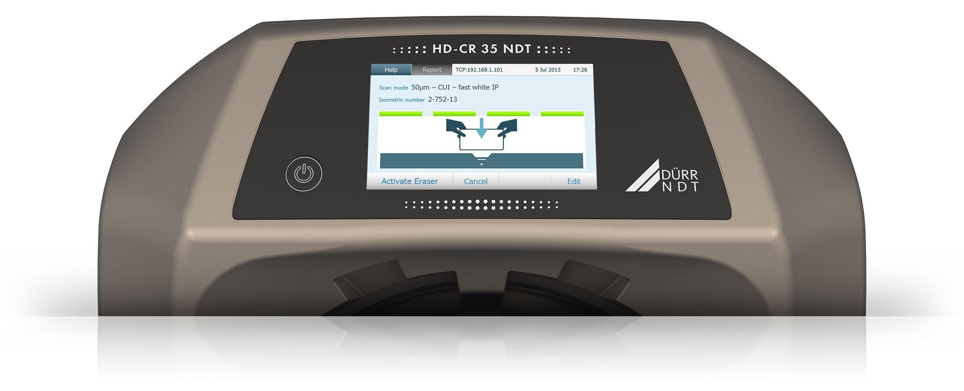
Ready to scan

Slide 35
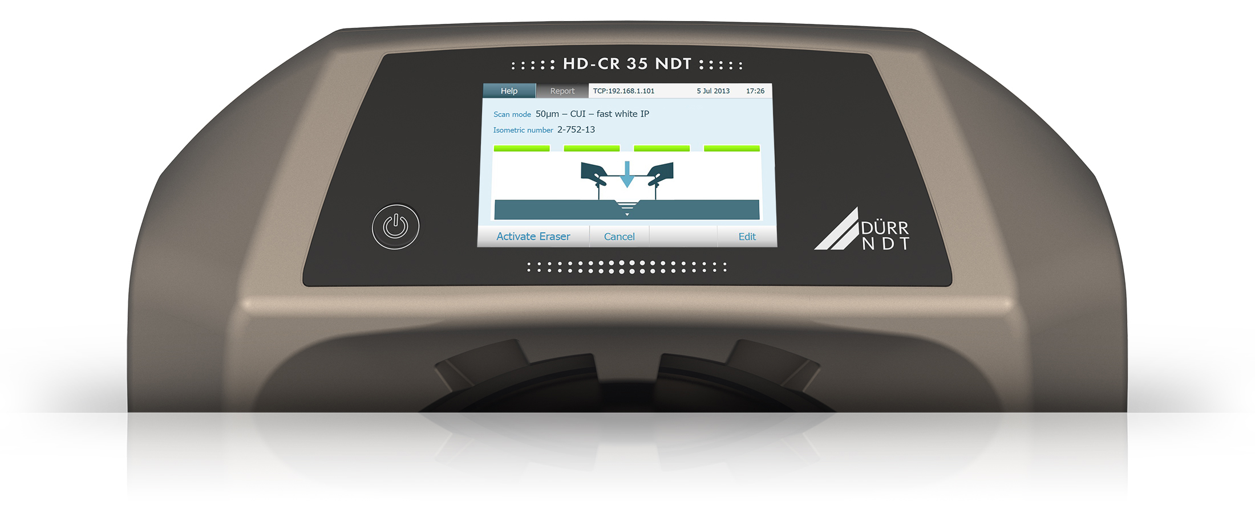
Ready to scan

Slide 36

Ready to scan

Slide 37
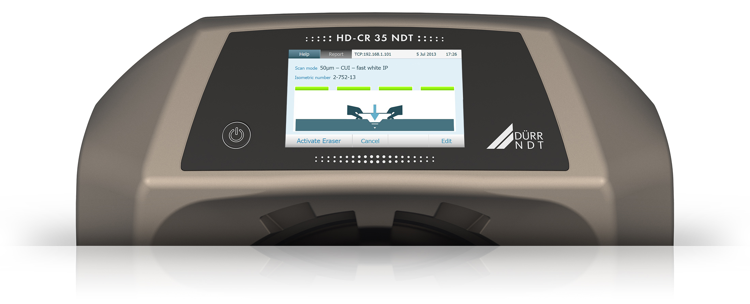
Ready to scan

Slide 38
Ready to scan

Slide 39
Ready to scan

Slide 40
Ready to scan

Slide 41
Ready to scan

Slide 42
Ready to scan

Slide 43
Ready to scan

Slide 44
Ready to scan

Slide 45
Ready to scan

Slide 46
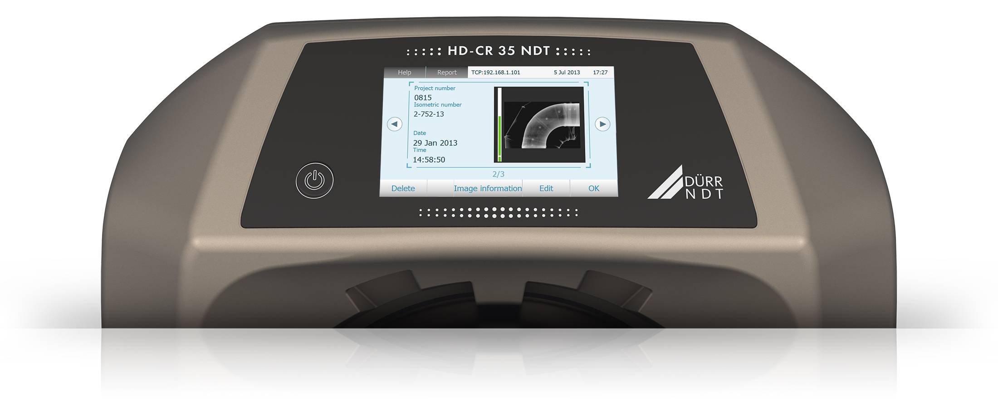

Scan completed

Slide 47
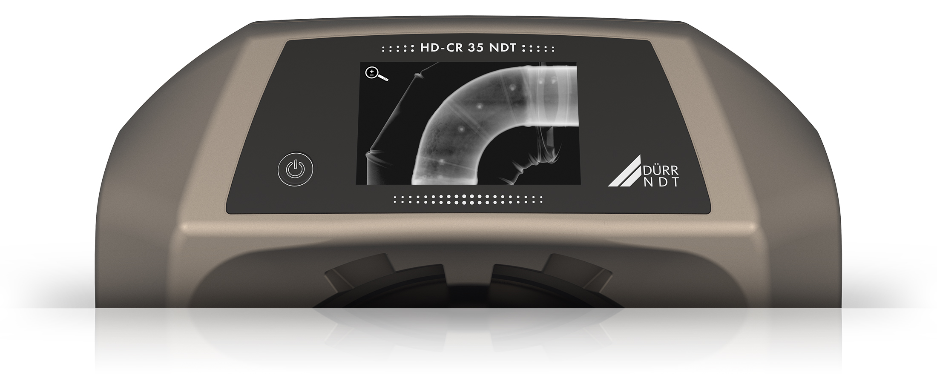
Preview screen

Slide 48
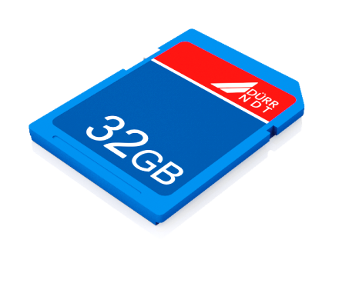
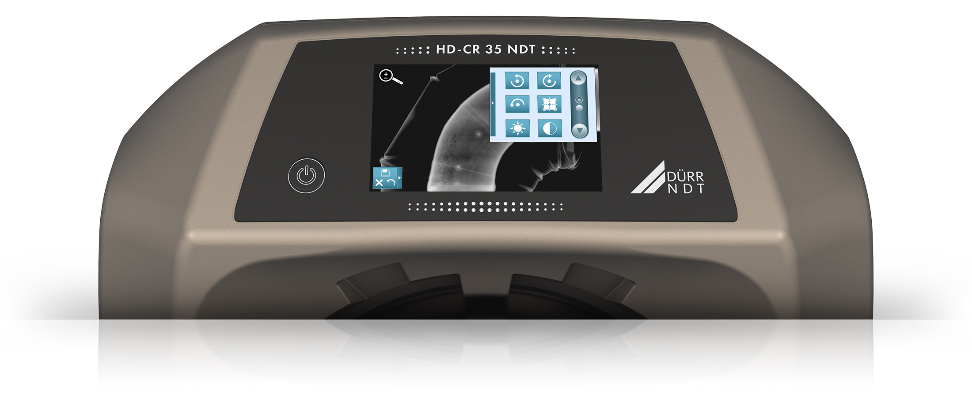

Manipulation and save to SD-Card

Slide 49
Benefit for mobile use
Equipment
All you need on site is the Scanner and IPs.
Operator (Level I)
Does not need to be trained on SW – just a little bit on how to scan an IP and
pre-evaluate the image.
Level II/III
Will get all the images like he gets films today. Interpretation after the
crew has returned the data.
Workflow/Personnel
The workflow is similar to film-use and the personnel does not need to be
specifically trained on SW.

Slide 50
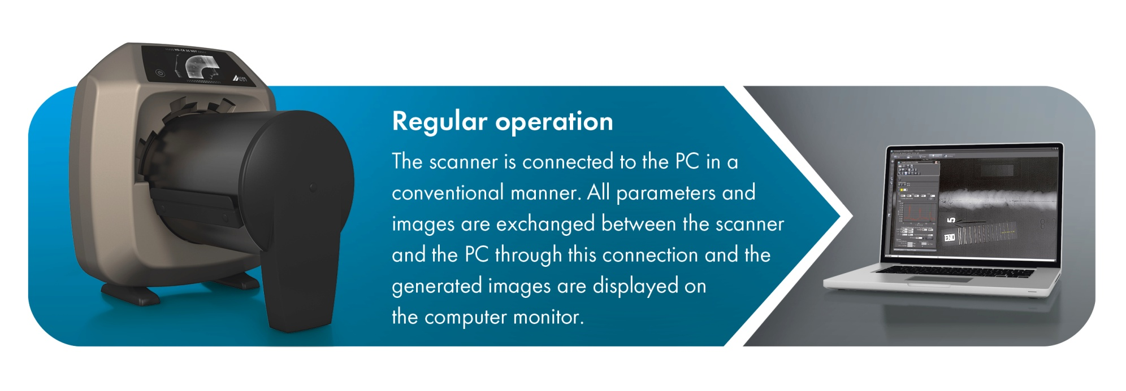
Regular use
A regular setup, where the scanner is directly hooked up to a Laptop/PC is possible also.

Slide 51
Summary
With the advanced technology realized
in the new HD-CR 35 NDT, the workflow
of Computed Radiography is closer to film
than ever before.
With very little training, every operator
is able to do the job, no matter whether
mobile or factory use.
Thanks to , highest SNR values
are always achieved.

Slide 52
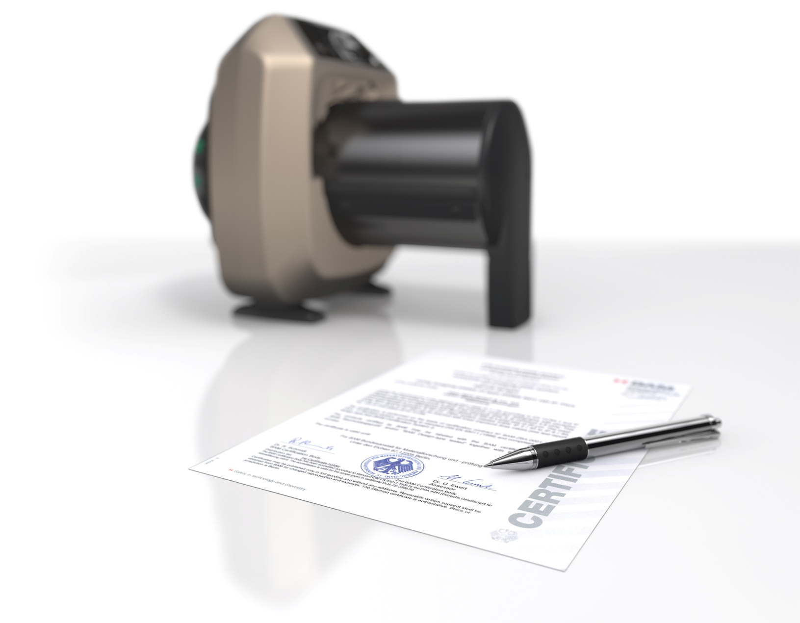

Certified and compliant
will be BAM certified
DICONDE compliant
ASTM compliant
EN compliant
ISO 9001
Quality

